Slide 1

0360-270 Advanced Web site Design
Abed Alkhateeb
PHP2

Slide 2
Profile Project
In this presentation, we will enhance the Profile Project to:
Add an image item, to insert the profile picture.
Read drop down list (Select item) values from lookup table
Add date item for Date of Birth (DOB column in Profile table)
We will change the extension of profiles_form.html to be profiles_form.php

Slide 3
profiles_form.php
Encrypt : Important for sending file to the action page
<html> <body>
<form action="insert_into_profiles.php" method="post" enctype="multipart/form-data">
<!-- get has to be capital GET , you can change to POST Capital too-->
First name: <input type="text" required name="fname"><br>
Last name: <input type="text" required name="lname"><br>
<!-- adding drop down lists that reads from user_codes table -->
<?php
if (!$link = mysql_connect('localhost', 'alkhate_db', 'XXXXXXX')) {
echo 'Could not connect to mysql';
exit;
}
Connect to database

Slide 4
profiles_form.php
if (!mysql_select_db('alkhate_db', $link)) {
echo 'Could not select database';
exit;
}
//create a select statement to get the values and description of the dropdown list from Database
$sql = 'SELECT user_code, user_description FROM User_codes';
$result = mysql_query($sql, $link);
if (!$result) {
echo "DB Error, could not query the database\n";
echo 'MySQL Error: ' . mfnameysql_error();
exit;
}

Slide 5
profiles_form.php
echo 'User Type: '; //print user type label
$select= '<select name="user_code">';
while ($rs = mysql_fetch_assoc($result)) {
$select.='<option value="'.$rs['user_code'].'">'.$rs['user_description'].'</option>';
} //loop to fetch the selected values and description and populate the list
$select.='</select>'; // closing tag the dot "." Means concatenate
echo $select;
?> <br>
Date of Birh: <input type="date" name="dob"><br>
Profile picture : <input type="file" required name ="picture" accept="image/*">
<input type="submit" value="Submit">
</form> </body> </html> <!--closing tags -->
Add 2 items, file to upload profile picture that only accept images, and DOB of type date

Slide 6
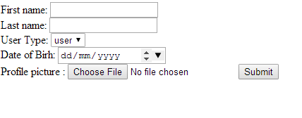
profiles_form.php

Slide 7
insert_into_profiles.php
In the following slides, we will enhance the insert_into_profiles.php code to do the following:
Receive the dob and picture values
Create one connection for each time we hit the database, once the results are fetched, we close the connection.
The slide show how to receive all <input type="file"> information, however, the code is only storing the picture itself in the profile table, specifically, picture column we've created in MySQL database.
You may utilize the non-used information of the picture, such as name , type, meme in your project if you like/need to.

Slide 8
insert_into_profiles.php
<?php
if (!$link = mysql_connect('localhost', 'alkhate_db', 'XXXXXX')) {
echo 'Could not connect to mysql';
exit;}
if (!mysql_select_db('alkhate_db', $link)) {
echo 'Could not select database';
exit;}
$sql = 'SELECT MAX(id) as id FROM Profiles';
$result = mysql_query($sql, $link);
if (!$result) {
echo "DB Error, could not query the database\n";
echo 'MySQL Error: ' . mfnameysql_error();
exit;}
while ($row = mysql_fetch_assoc($result)) {
$id = $row['id'] ;}
$id = $id + 1;
mysql_free_result($result);
?>

Slide 9
insert_into_profiles.php
<?php
// get all elements that have been sent by Profiles_form.php,
$fname = $_REQUEST['fname'];
$dob = $_REQUEST['dob'];
$lname = $_REQUEST['lname'];
echo $dob;
$user_code = $_REQUEST['user_code'];
echo $user_code;
$link = new mysqli('localhost', 'alkhate_db', 'Mariam10', 'alkhate_db');
if(mysqli_connect_errno()) {
die("MySQL connection failed: ". mysqli_connect_error());
}

Slide 10
Insert_into_profile.php .. Getting sent pic info
if(isset($_FILES['picture'])) {
// Make sure the file was sent without errors
if($_FILES['picture']['error'] == 0) {
// Gather all the sent file information
$name = $link->real_escape_string($_FILES['picture']['name']);
$mime = $link ->real_escape_string($_FILES['picture']['type']);
$data = $link ->real_escape_string(file_get_contents($_FILES ['picture']['tmp_name']));
$size = intval($_FILES['picture']['size']);
echo $name;
}
We are only going to using data for this example, you may use the other info

Slide 11
Insert_into_profile
else {
echo 'An error accured while the file was being uploaded. '
. 'Error code: '. intval($_FILES['picture']['error']);
}
}
else {
echo 'Error! A file was not sent!';
}
$link->close();
?>
Returns the error of uploading the file item “picture”

Slide 12
Insert_into_profile.php
<?php
if (!$link = mysql_connect('localhost', 'alkhate_db', 'XXXXXXX')) {
echo 'Could not connect to mysql';
exit;}
if (!mysql_select_db('alkhate_db', $link)) {
echo 'Could not select database';
exit;}
$sql_insert = "INSERT INTO Profiles (id, fname, lname,DOB,picture,usercode)
VALUES (".$id.",'".$fname."','".$lname."', STR_TO_DATE('".$dob."', '%Y-%m-%d'),'".$data."','".$user_code."')";
$result1 = mysql_query($sql_insert , $link);
STR_TO_DATE function to format the date variable(dobb) bfore inserting it to the database

Slide 13
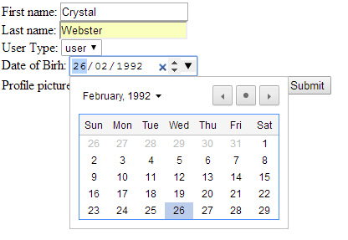
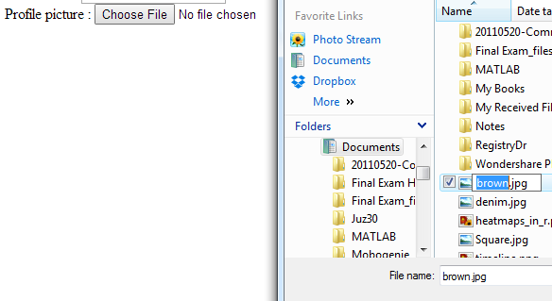
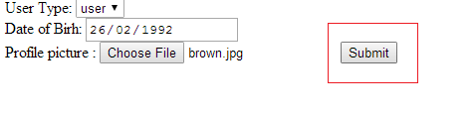
Insert_into_profile.php
if (!$result1) {
echo "DB Error, could not insert into the database\n";
echo 'MySQL Error: ' . mfnameysql_error();
exit;}
echo "the file has been sucessfully inserted";
$link->commit();
?>

Slide 14
Check out the project
http://alkhate.myweb.cs.uwindsor.ca/assignment1/profiles_form.php

Slide 15
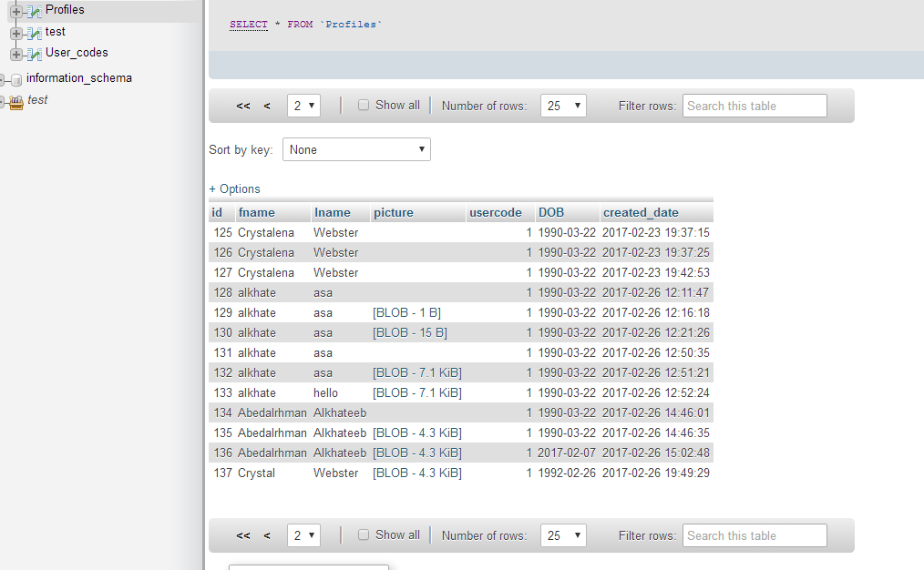
Check out the database, once it's implemented
DOB takes the value sent from the date item
Id = id + 1 for new record
Picture is saved as blob

